Slide 1
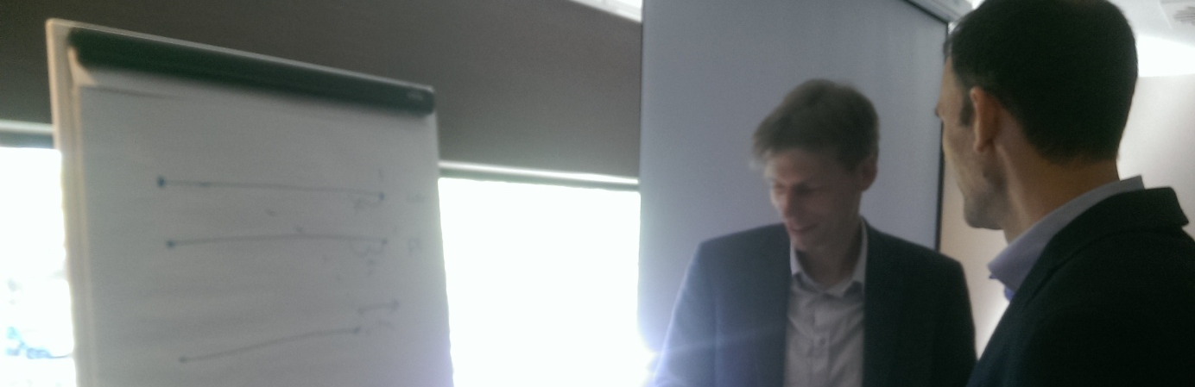
Appraisal methodologies for seamless mobility

Slide 2
“Slower” Mobility?
Still travel time savings account for 80% of project benefits in traditional cost-benefit analyses. Other social impacts deserve more relevance, by type of user, trip purpose, mode of transport, moment of the trip, origin and/or destination...
New generations behave and travel differently: comfort, convenience, safety, sociability, reliability… are increasingly important.

Slide 3
Just travelling?
Public transport (just like public spaces and facilities) are open to citizens of any origin, age or class, and provide opportunities for spontaneous socialisation.
How to assess social positive externalities –”goods that have no market” (e.g. conviviality) linked to transport?

Slide 4
Going Hybrid?
New hybrid mobility technologies are emerging (e.g. individual use, collective ownership, public management).
New technologies are already challenging conventional transport modes (e.g. trucks/trains, private/public, individual/collective)

Slide 5
Seamless Mobility?
Interchanges are today increasingly important (e.g time spent while interchanging between modes can be valued 50% or even 100% as much as time travelling, and time spend waiting 100% to 200%)
Smart integration between all transport and communication networks (e.g resources, freight and passenger transport, energy, information) at all scales.

Slide 6
More complex governance?
The perception of costs and benefits are different from different stakeholder perspectives.
Uncertain assessment: Need for monitoring the flows of economic transferences between stakeholders.
Policy assessment focused to provide rational reference information useful in a negotiation participatory process –a learning process for all)

Slide 7
Recreating the landscape?
Environmental externalities in transport appraisal do not fully reflect the social conflict linked to environmental change
Cultural aspects are the key!

Slide 8
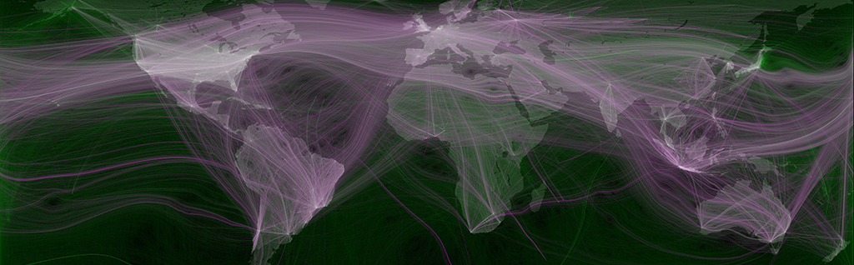
THANK YOU!
For more information please contact:
Andreu Ulied
Contact details
ulied@mcrit.com

